Slide 1

What is DevOps?

Slide 2

DevOps Meaning
DevOps is an operational philosophy that promotes better communication between development and operations for achieving goals
DevOps is a culture and practice that aims at unifying Development and Operations in an organization and improves the performance of the organization

Slide 3
Benefits of DevOps
Improves customer experience and satisfaction
Continuous Software Delivery
Less complexity and better management
Faster resolving of problems
Better employee engagement
Better and stable operating environments
Improved communication and collaboration
Increased effectiveness
Client
Technology
Organisation

Slide 4
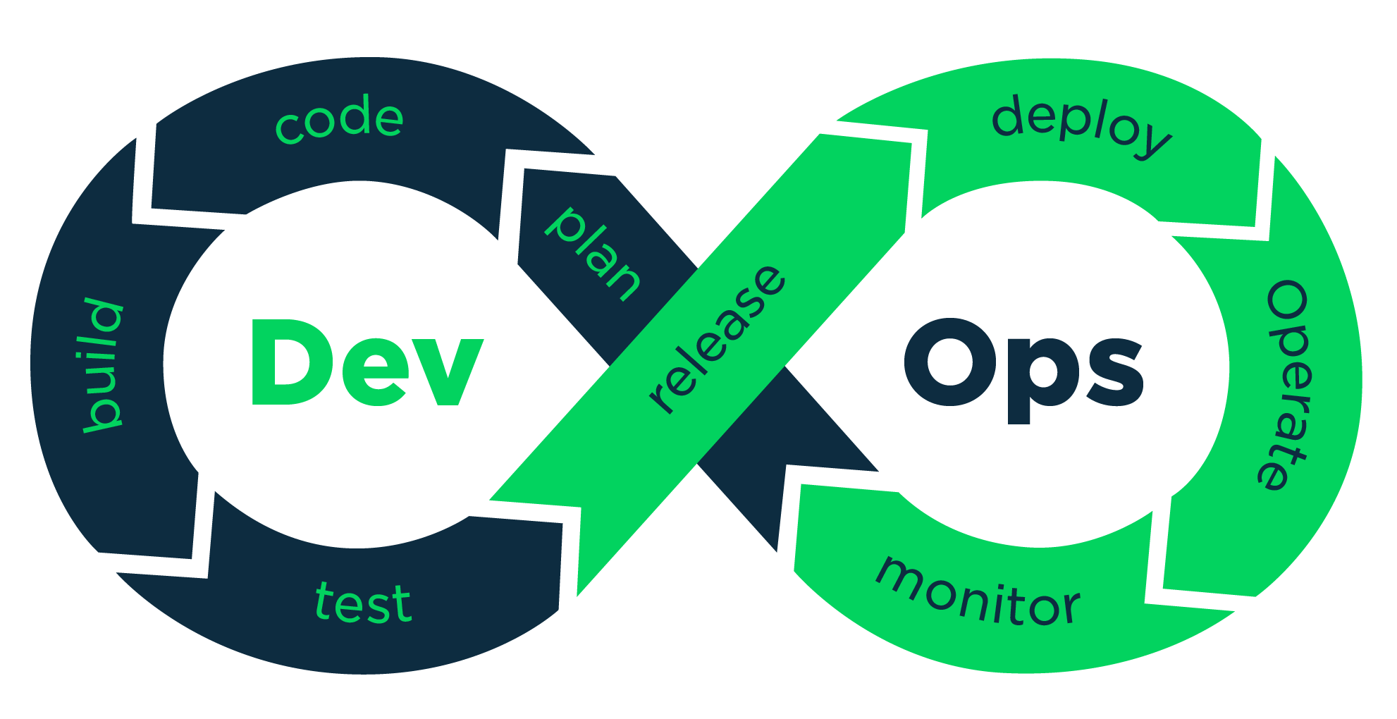
DevOps Process
A Set of process that follows continuously in software delivery
Plan
Code
Build
Test
Release
Deploy
Operate
Monitor

Slide 5
Devops modules in IIHT
DEVOPS
Introduction to DevOps
Introduction to Cloud Computing
GIT
Chef
Puppet for Configuration Management
Jenkins for CI/CD
Docker for DevOps

Slide 6

Job Roles
A Certified DevOps Professional can work in multiple roles like
DevOps Evangelist
Release Manager
Automation Architect
Utility Technology Player
DevOp s Architect

Slide 7

Blended Learning module of IIHT
IIHT is the pioneer in providing cloud training technologies. The students will be exposed to the unique live Interactive sessions where the students will be given access to the IIHT’s highly acclaimed learning management system, where they will be working on real-time projects for better hands-on experience in a simulated platform the first of its kind.

Slide 8
About IIHT
IIHT is a leading IT talent transformation company and a technology evangelist in the retail and enterprise space. Having dedicated over two decades in creating learning paths for freshers and professionals that are closely aligned with the demands of the IT industry, IIHT has truly been a pioneer in technology training. At IIHT, we recognize the requirements of the IT industry and work towards tackling challenges that prevent the growth of both the enterprise and its workforce. All of IIHT’s courses are well designed, adopting a convenient and thorough stack approach for IT job aspirants who need training to be job ready and for IT professionals waiting to progress in their careers. By adopting blended learning, a live and interactive virtual classrooms, IIHT’s reach has now gone even beyond borders.

Slide 9
Contact us
Address:
Corporate Office : 15, 4th Floor, Sri Lakshmi Complex, Off MG Road, Near SBI LHO Bangalore – 560 001, India
Toll free : 1800-123-321-5
WhatsApp : +91-95130-72227
Email Us : interest@iiht.com
Website : www.devopsstack.iiht.com

Slide 10
Thank You

